Slide 1
“Use It or Lose It?”
What do you think this means?

Slide 2
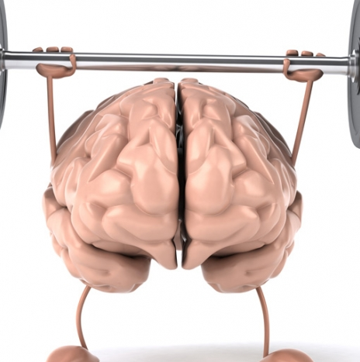
Use It or Lose It!
Social Studies 7
Dr. Knox Middle School
2016-2017

Slide 3
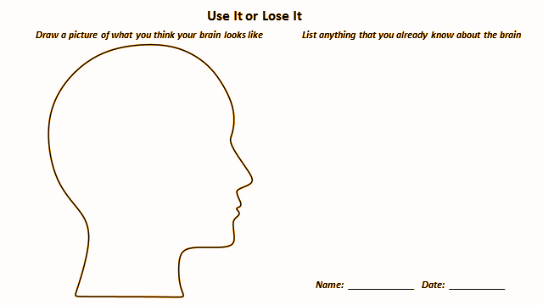
Before We Begin!
Share everything you know about the human brain.
1. On the paper given to you, draw a picture of what you think your brain looks like.
2. Beside this drawing, write down anything you know about your brain.

Slide 4
Activate Our Thinking
Game time!
Work with the person sitting beside you.
Determine A/B partners
Get an Ipad, passwords for all is “1234”
Google search “Neuroscience for kids stroop puzzle”
Click on this link Neuroscience for Kids - Puzzle
faculty.washington.edu/chudler/jstro.html
Click and drag each piece to complete the puzzle.
When you are finished, you can send it to a friend as a postcard. ... Stroop …
DO NOT START YET!!!!!!

Slide 5
Activate Our Thinking
Game time!
A will do the jigsaw first, and B will record A’s time on the stickee. Switch roles so B has an opportunity to do the jigsaw, A will record B’s time. (This is NOT a competition with each other, simply a personal best)
When you have both had a chance to play, return to your desk, park your stickee at the top of the desk, and place Ipad to the side and turn off the screen. Don’t shut it completely off - we’ll use it later. :)

Slide 6
Our Learning Target
To understand that our brain is like a muscle that gets stronger with use, and that we can apply this understanding to challenging tasks, to become more resilient and effective learners.

Slide 7
Brain Science!

Slide 8
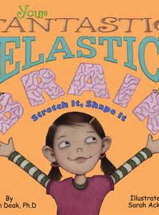
How Does Our Brain Work?
Listen and observe during read aloud. RECORD what especially interests or surprises you!
Add any information that you learn to the brain diagram you have already drawn.
Was your prior knowledge correct? ✔
Did you have an “A-ha” moment? ❗
Is this important information? ★
Did you make a connection? ∞

Slide 9
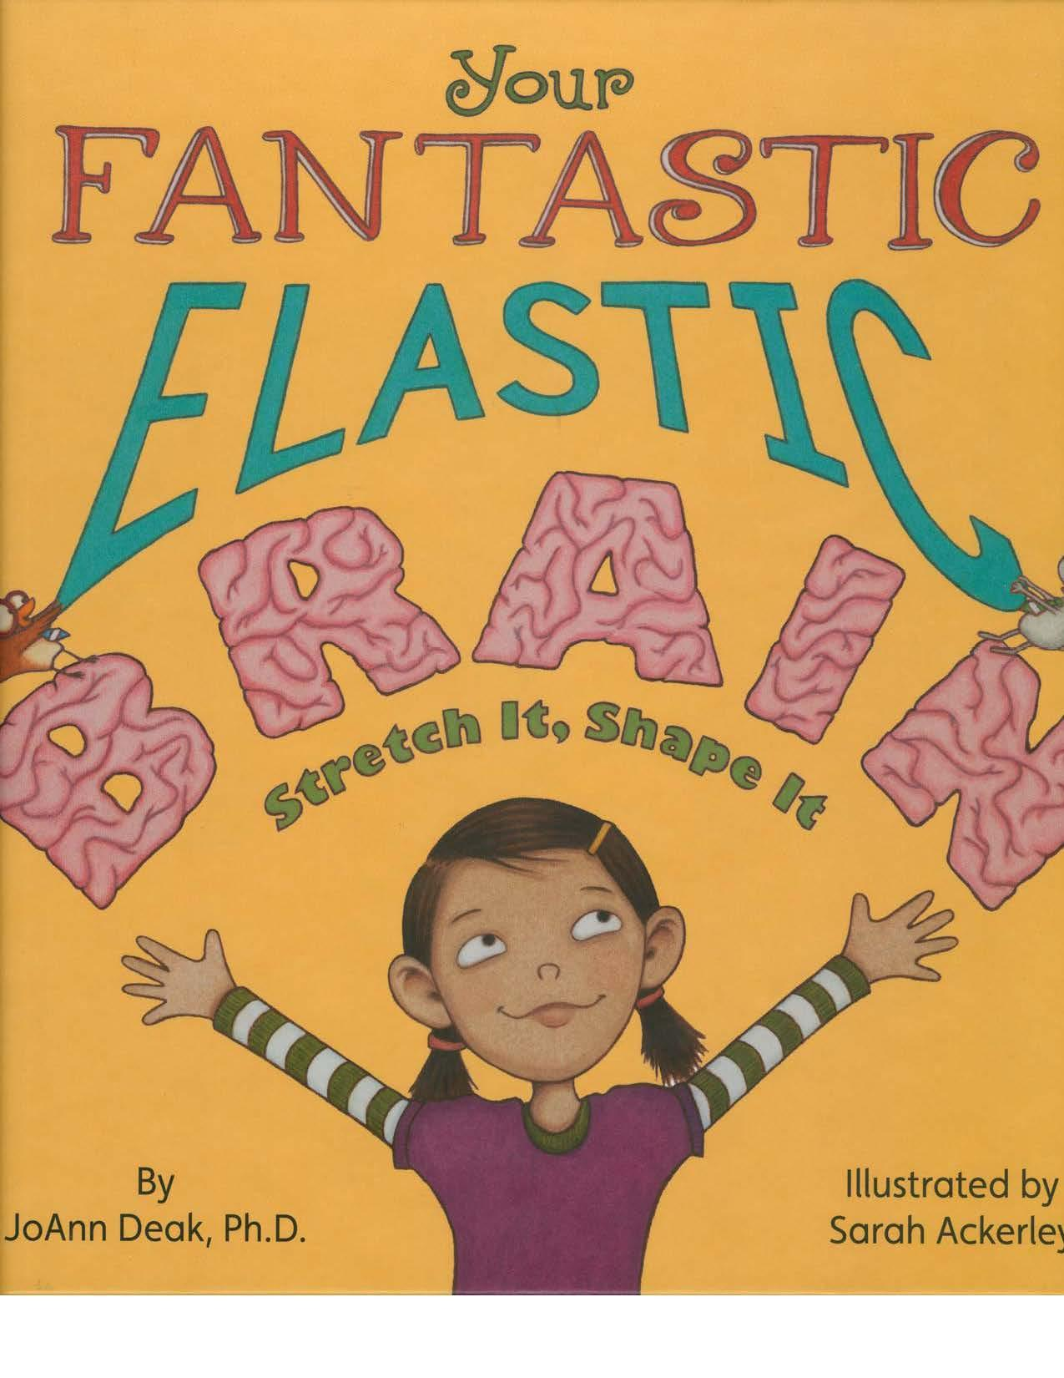

Slide 10
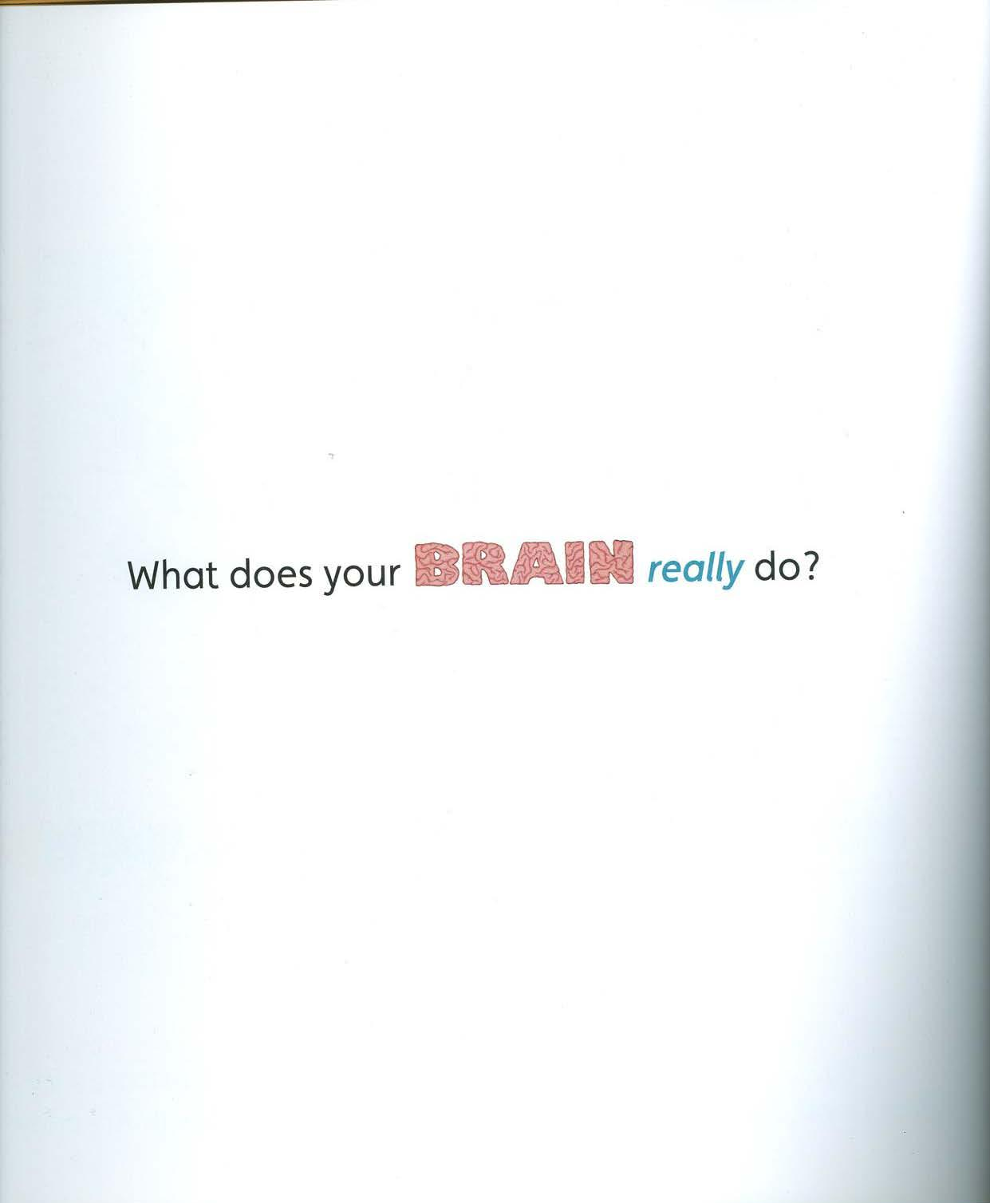

Slide 11
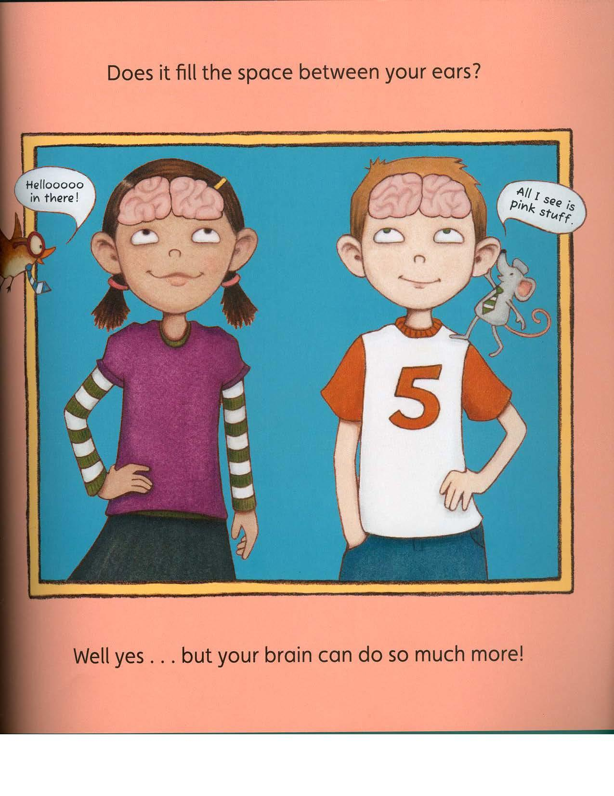

Slide 12
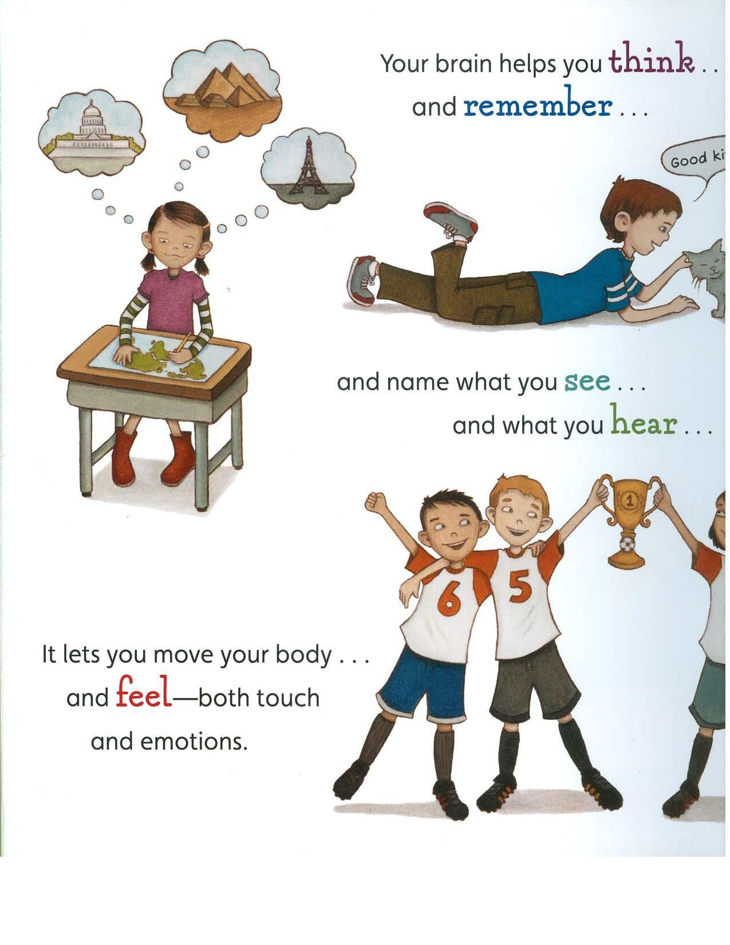

Slide 13
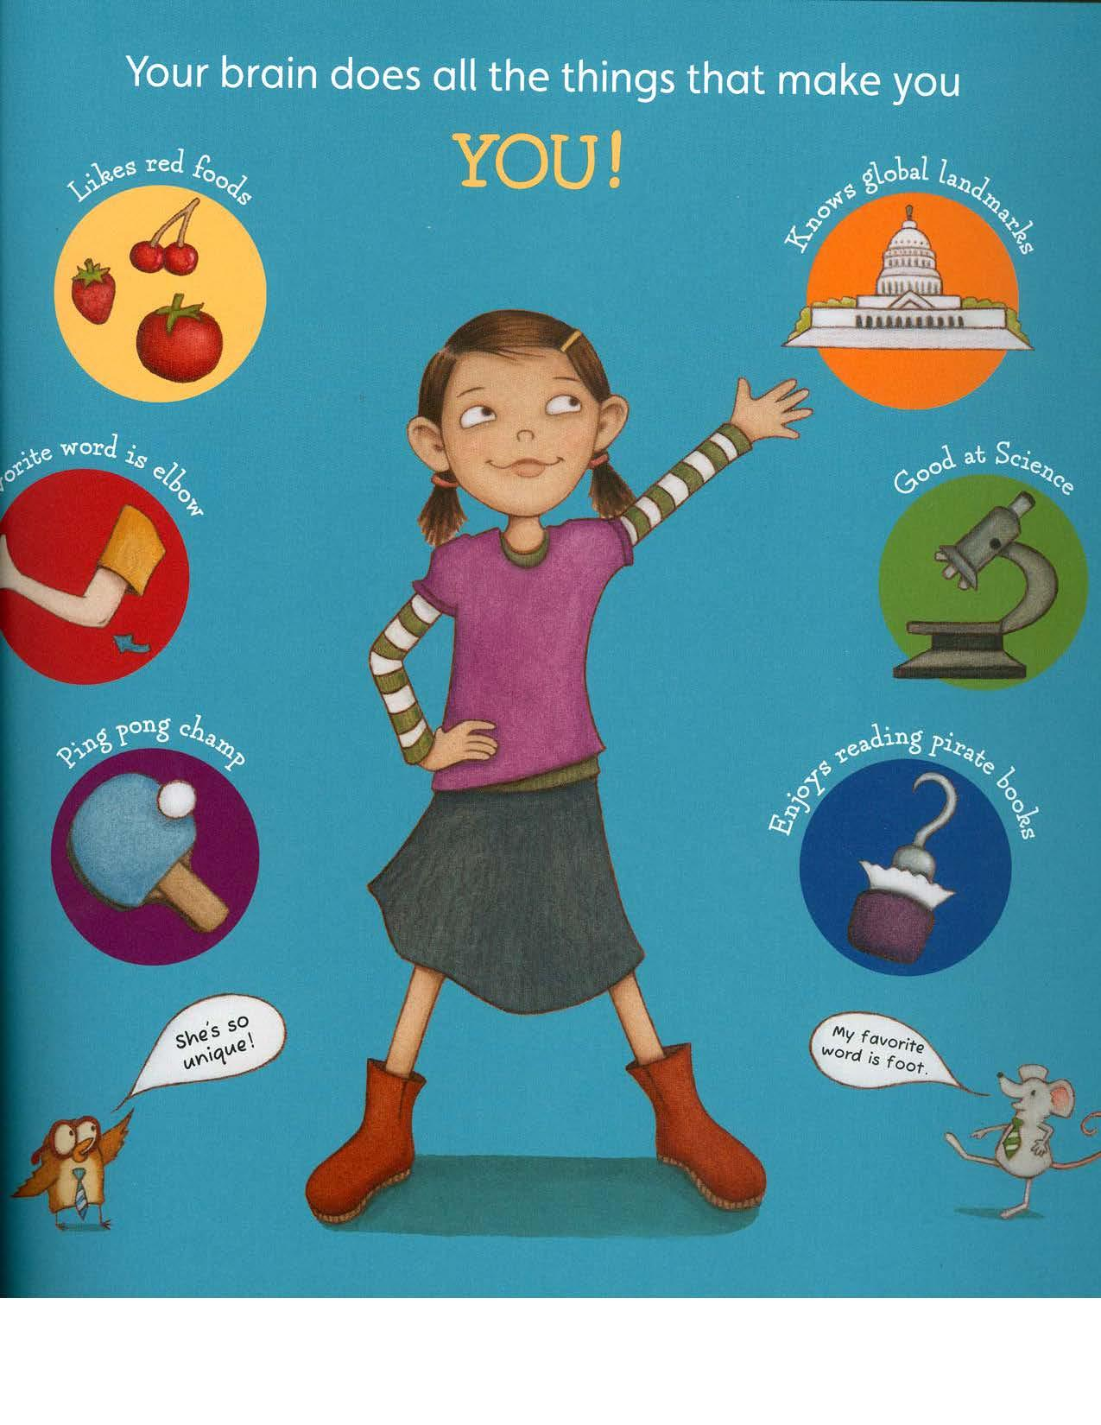

Slide 14
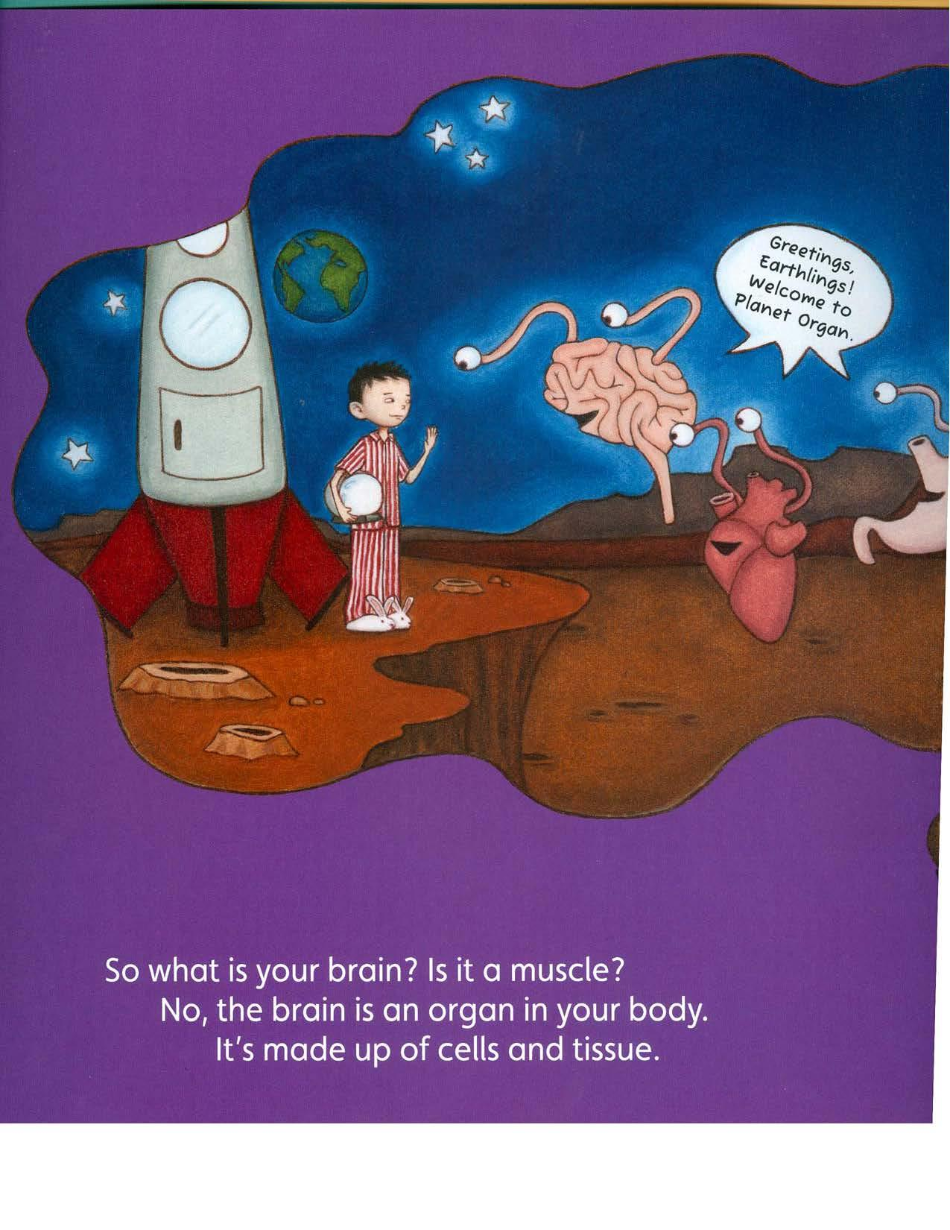

Slide 15
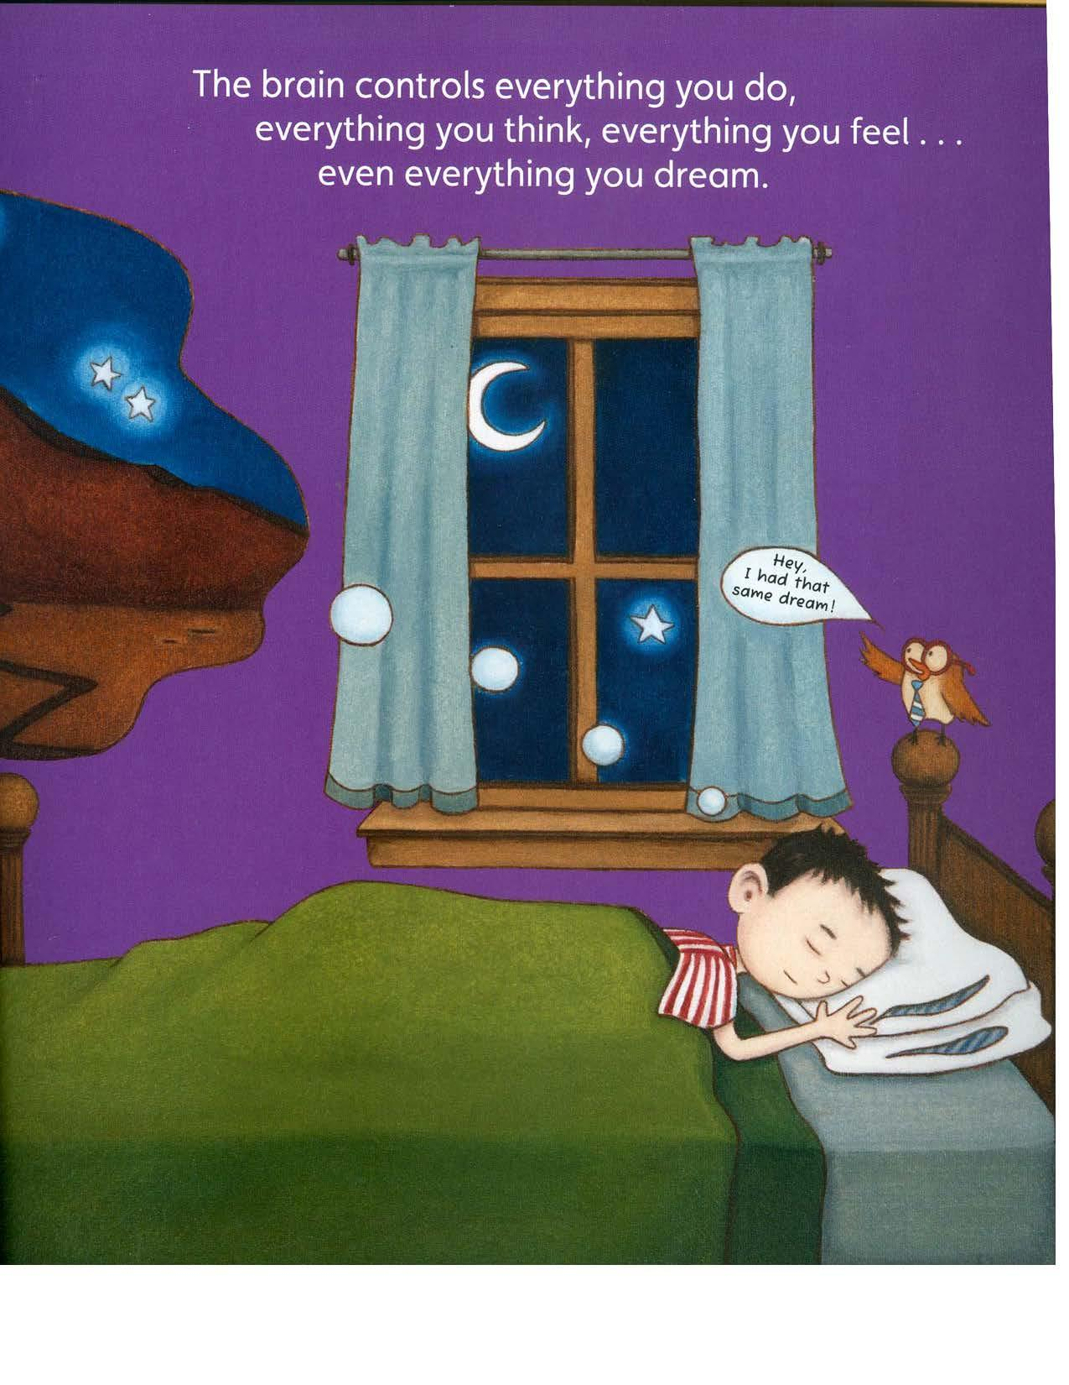

Slide 16
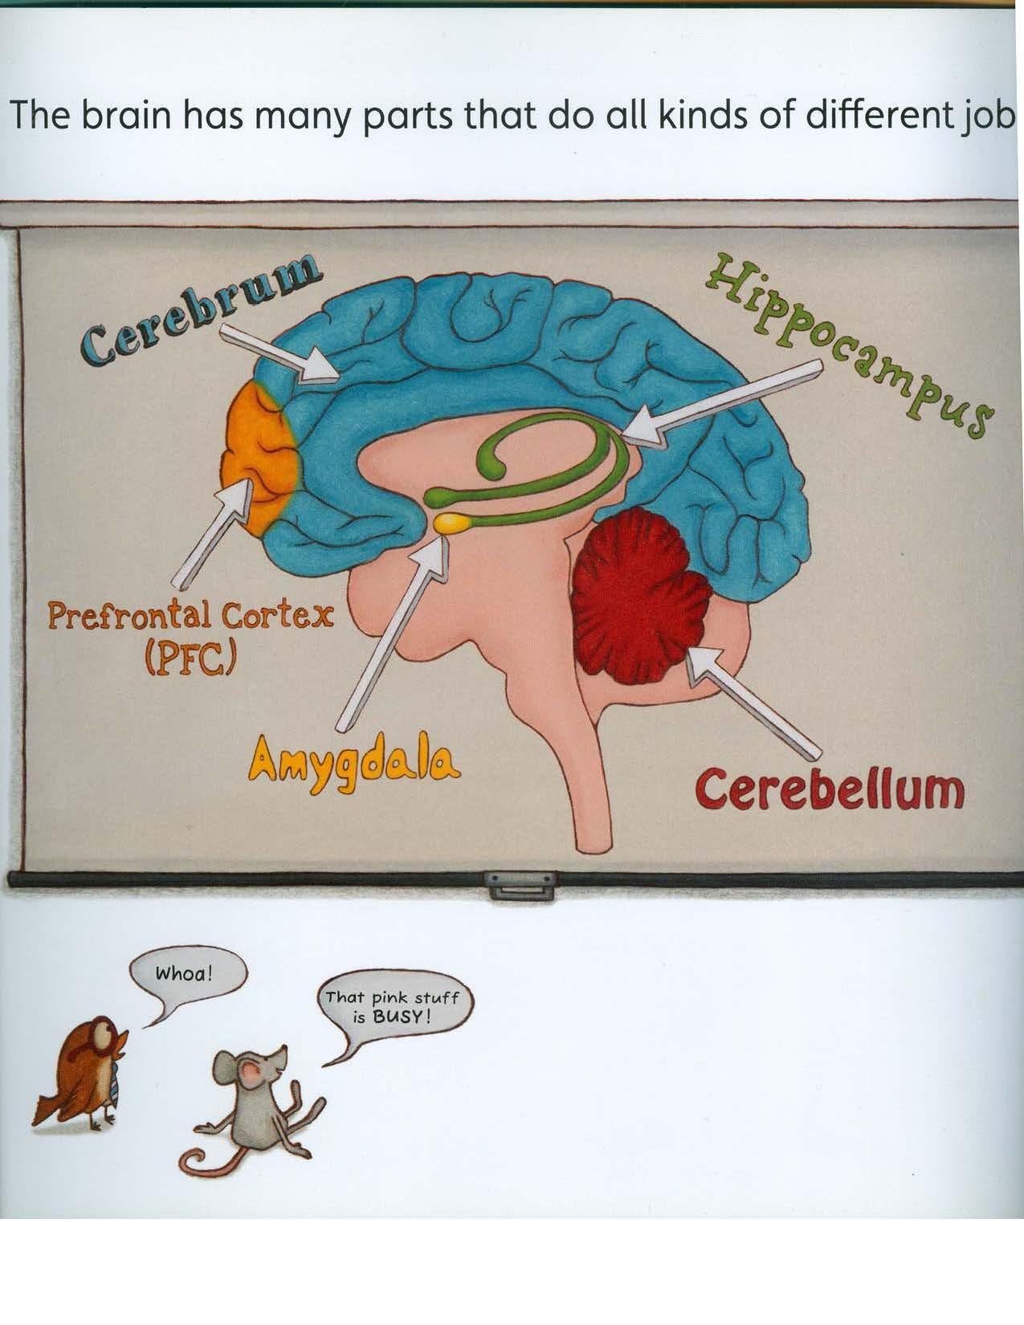

Slide 17
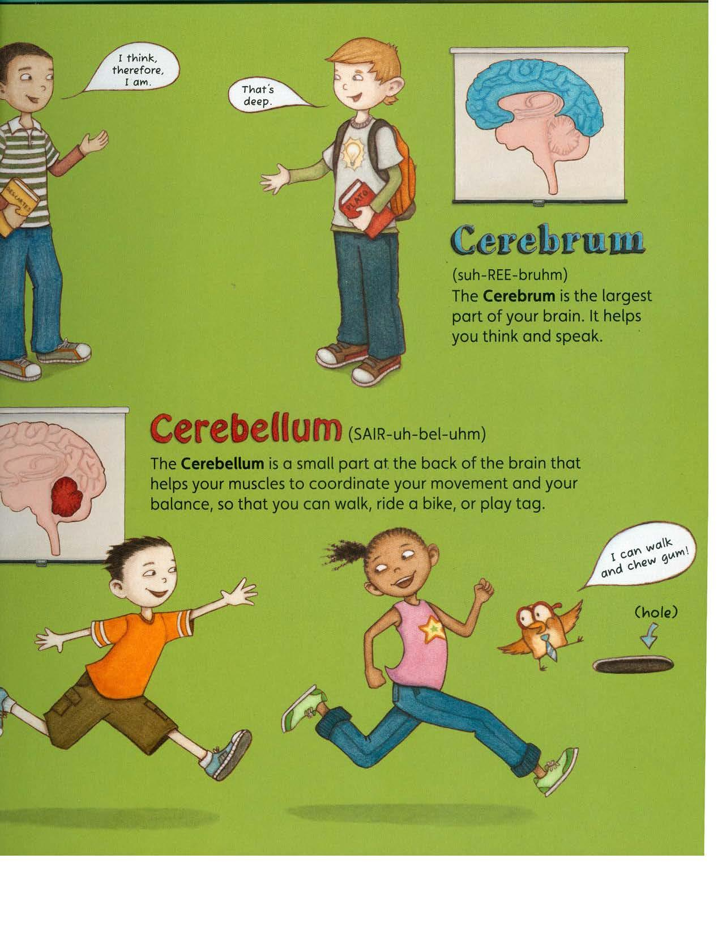

Slide 18
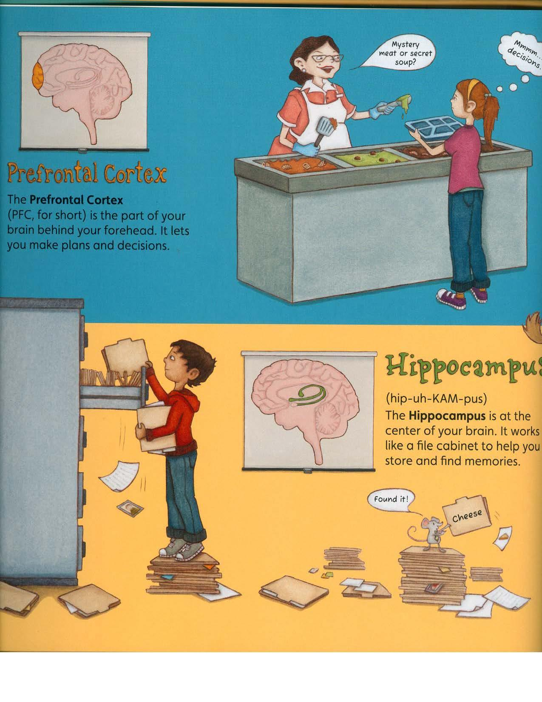

Slide 19
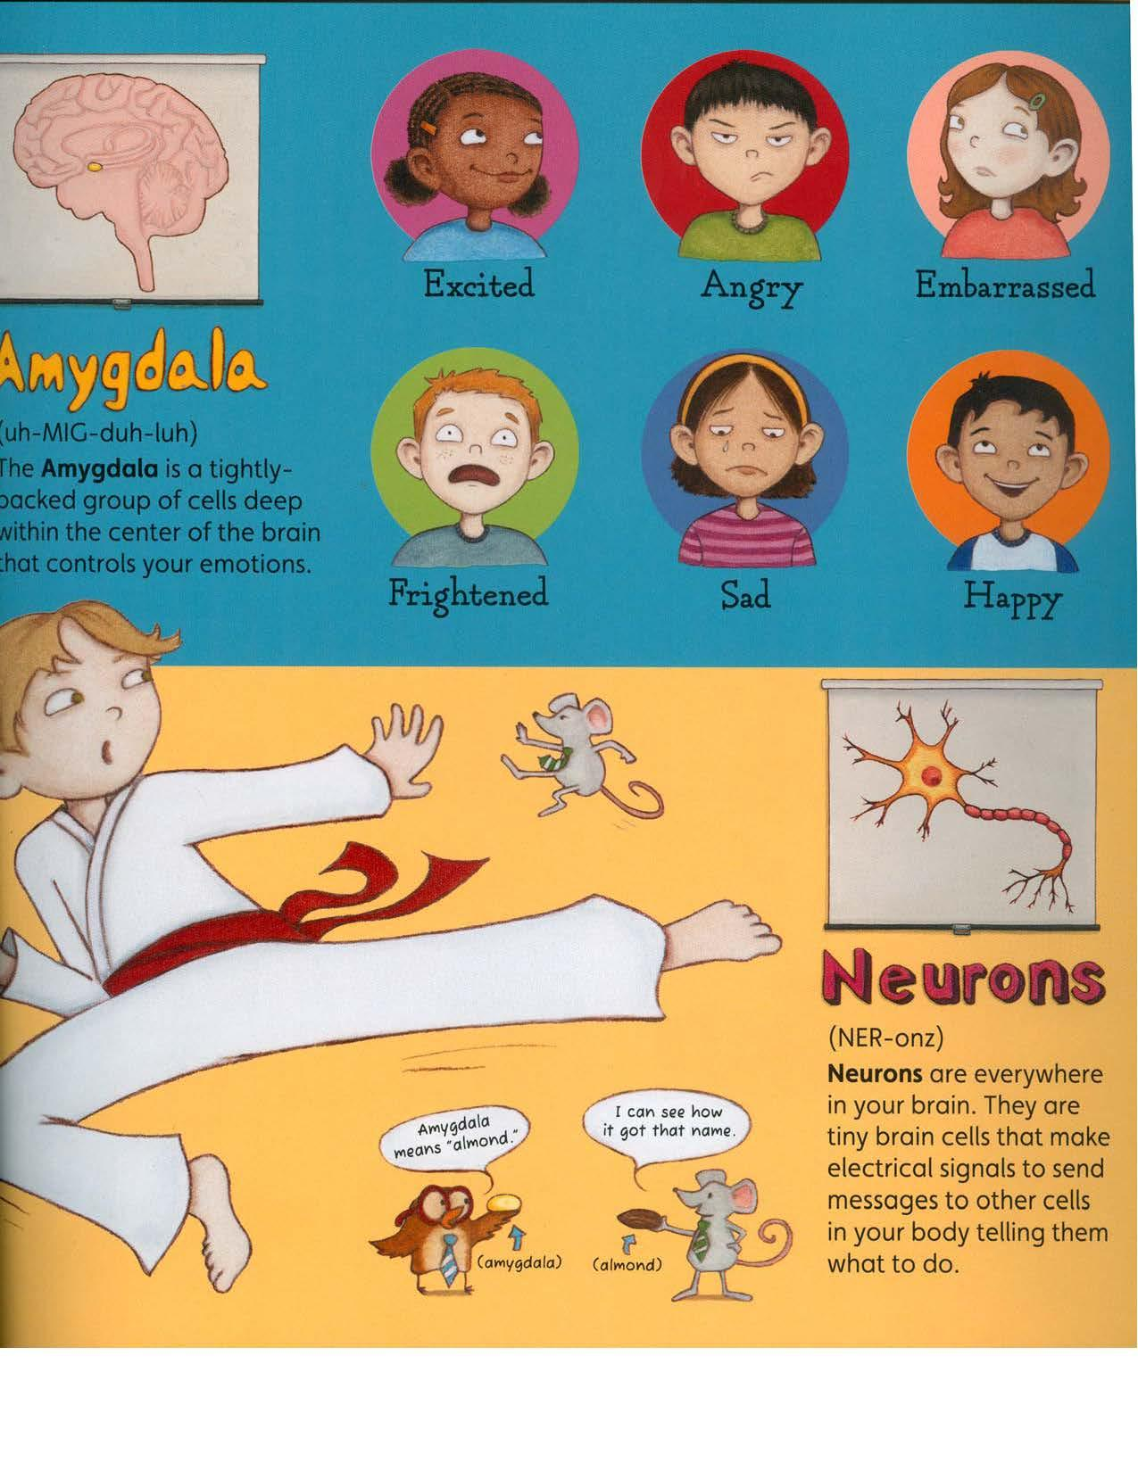

Slide 20
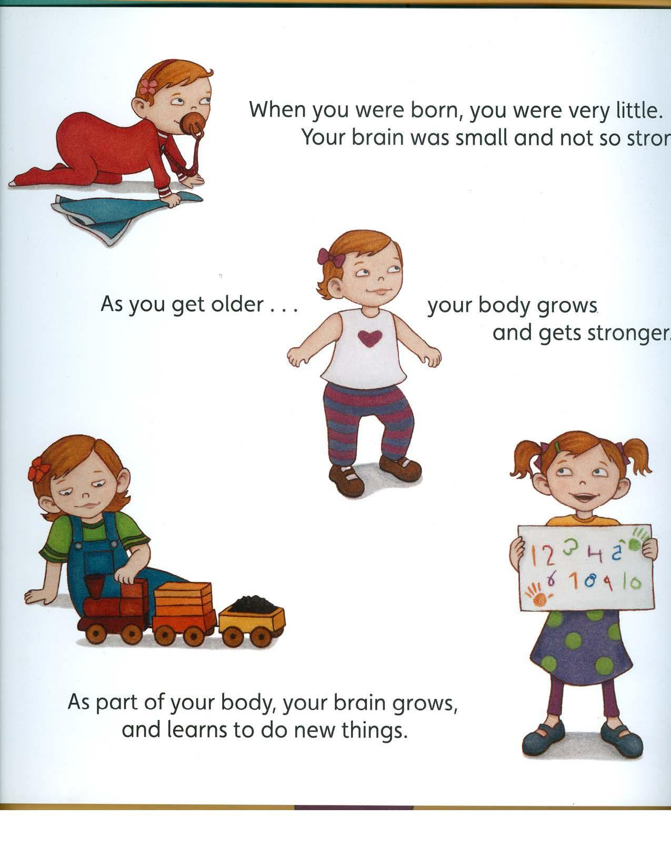

Slide 21
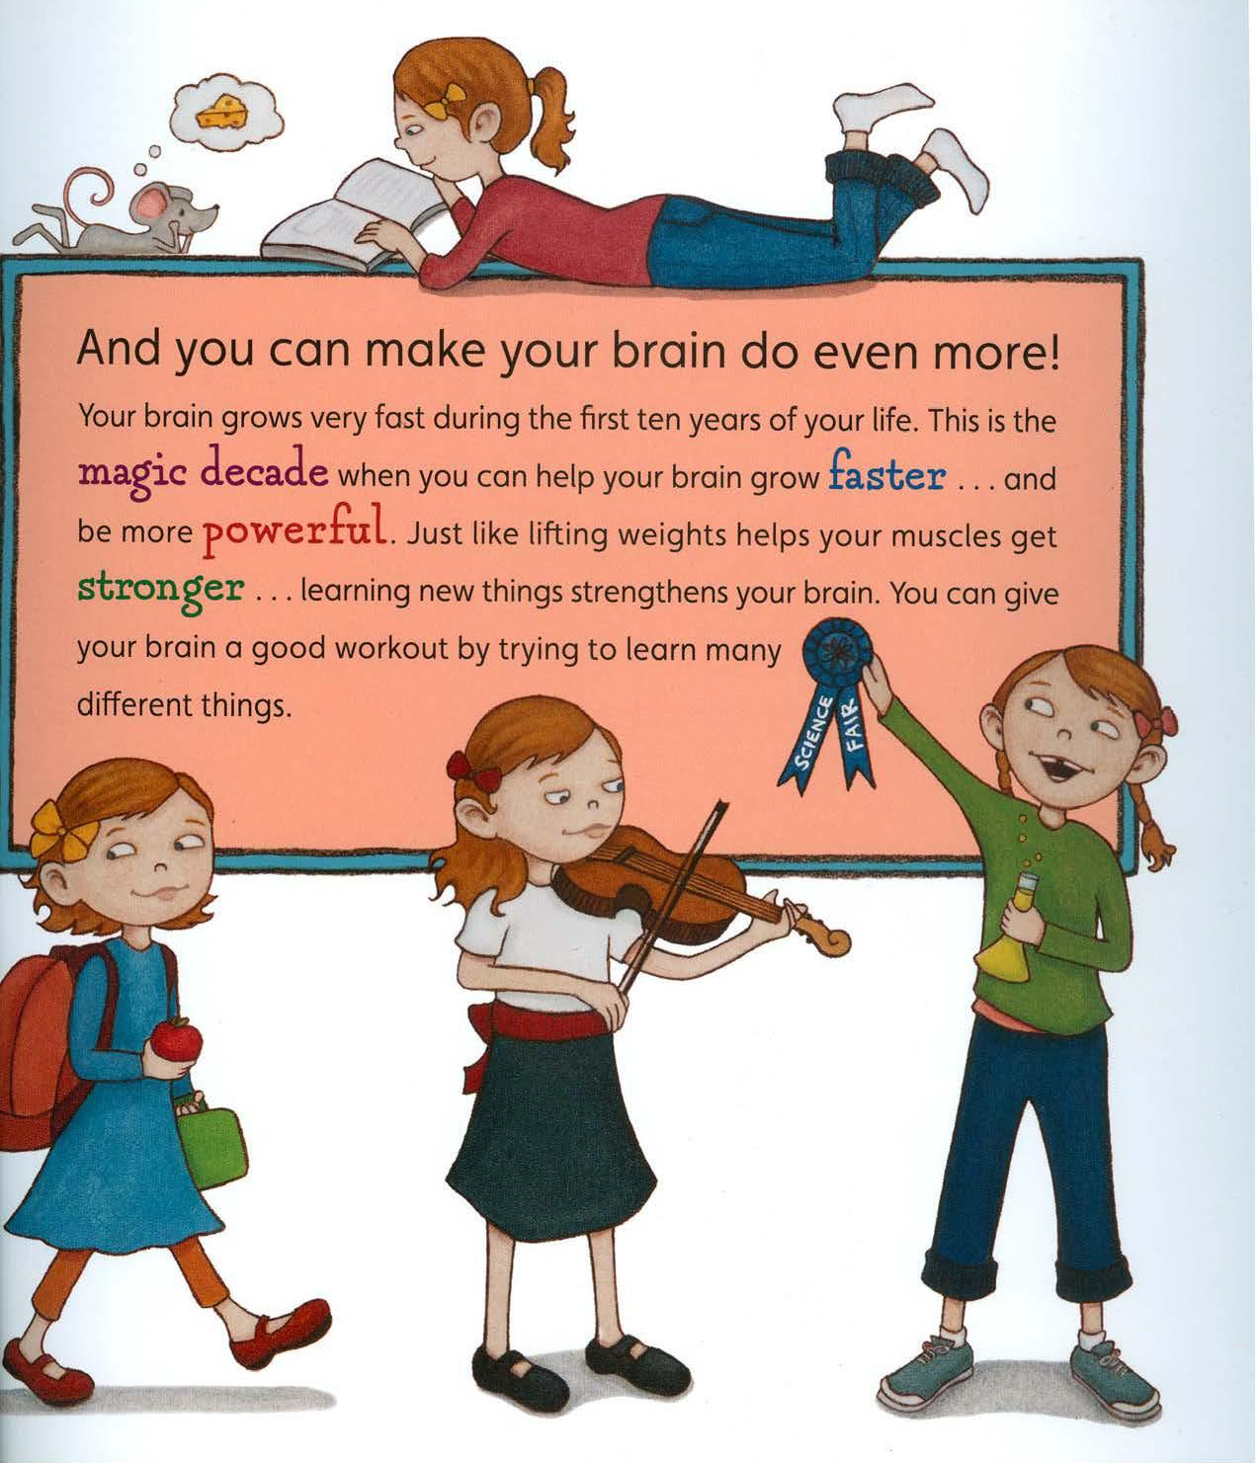

Slide 22
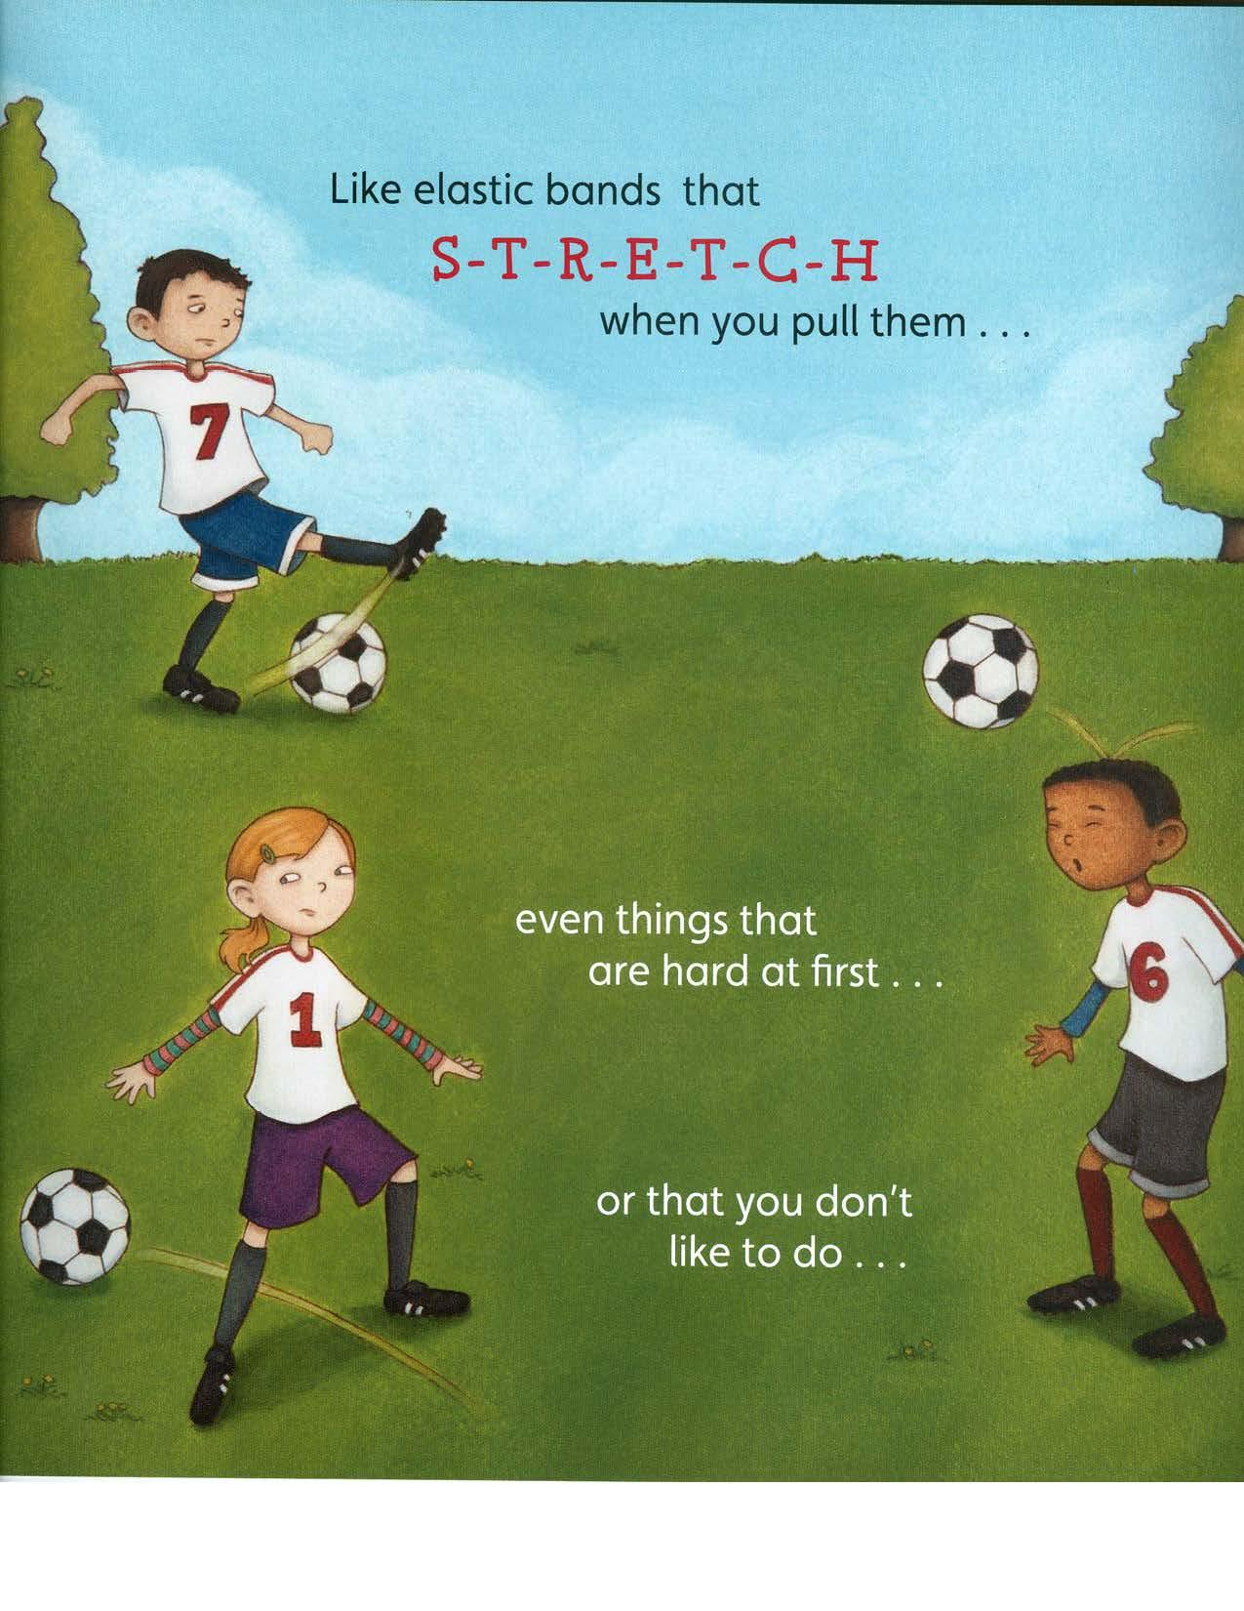

Slide 23
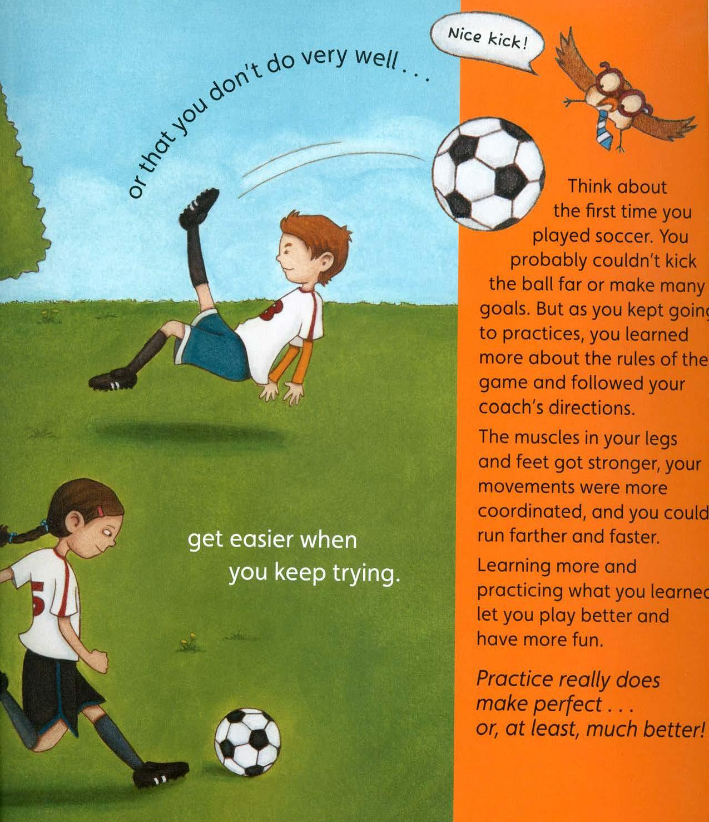

Slide 24
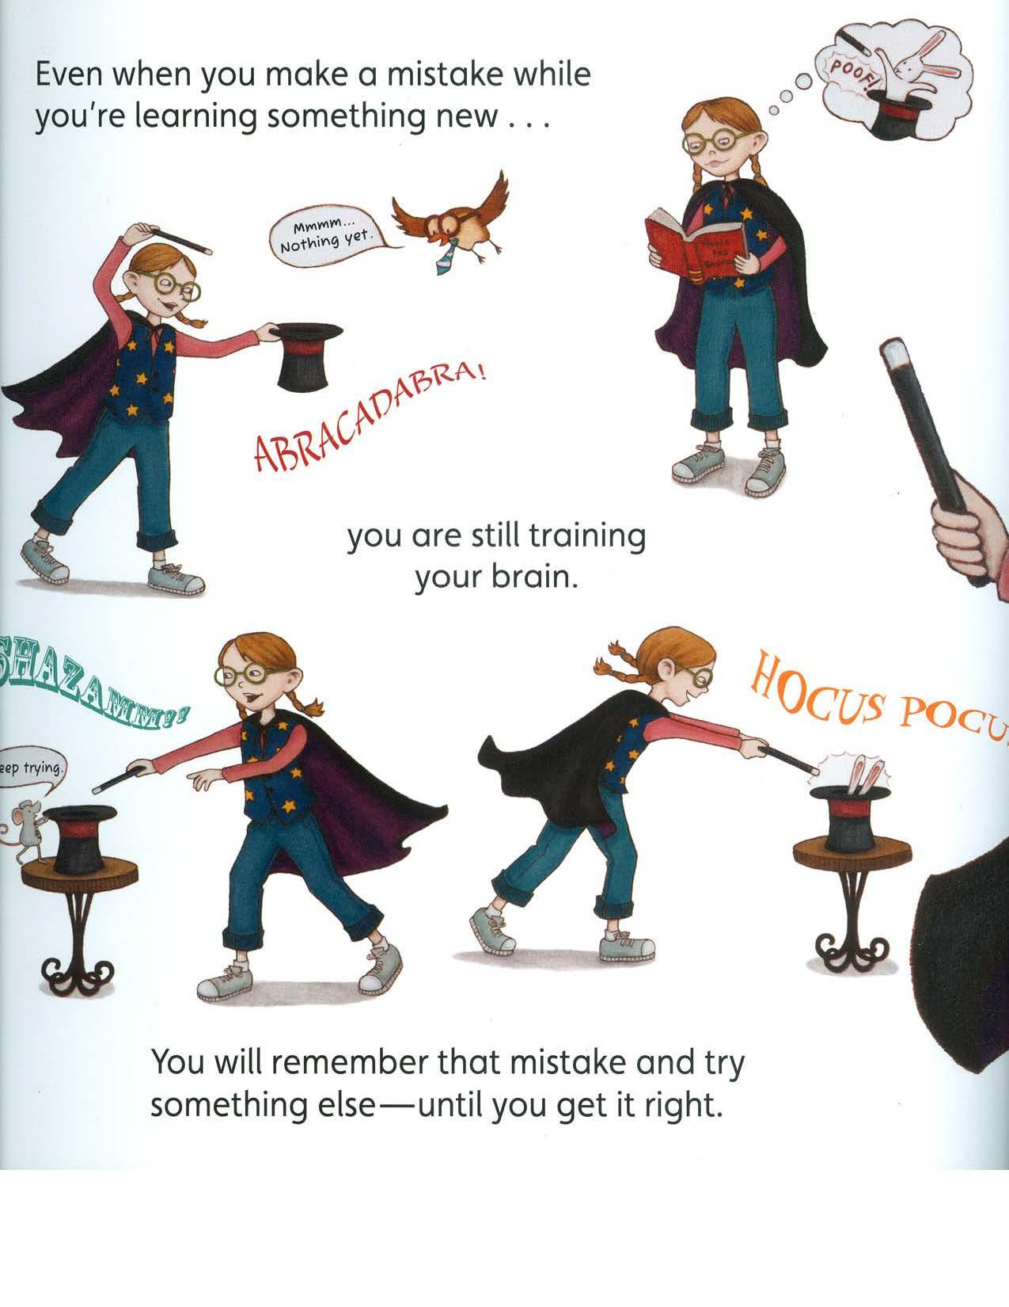

Slide 25
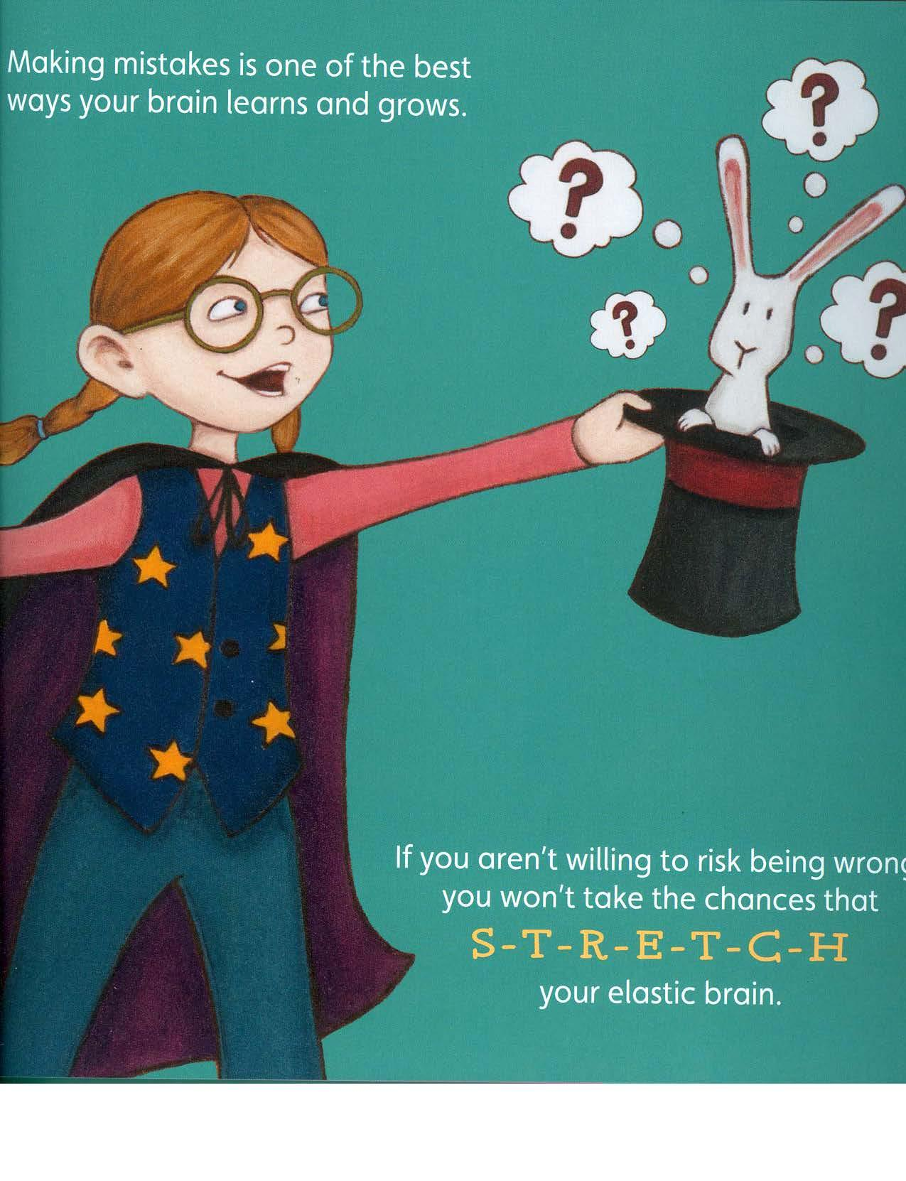

Slide 26
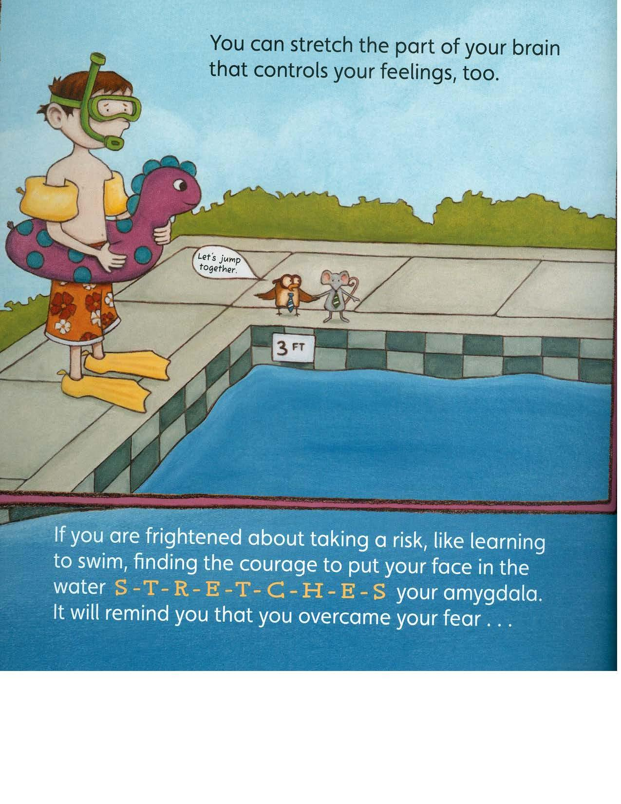

Slide 27
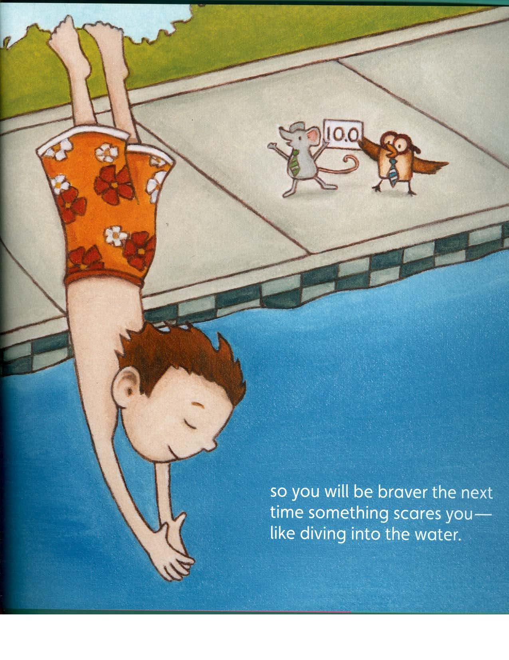

Slide 28
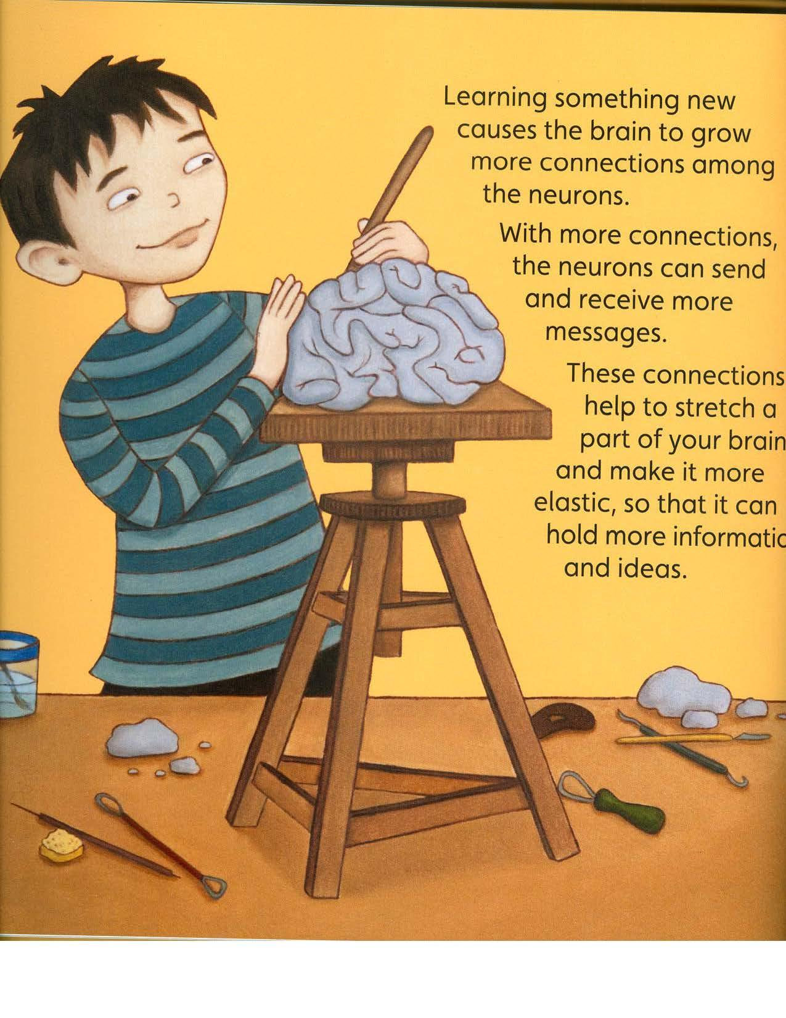

Slide 30
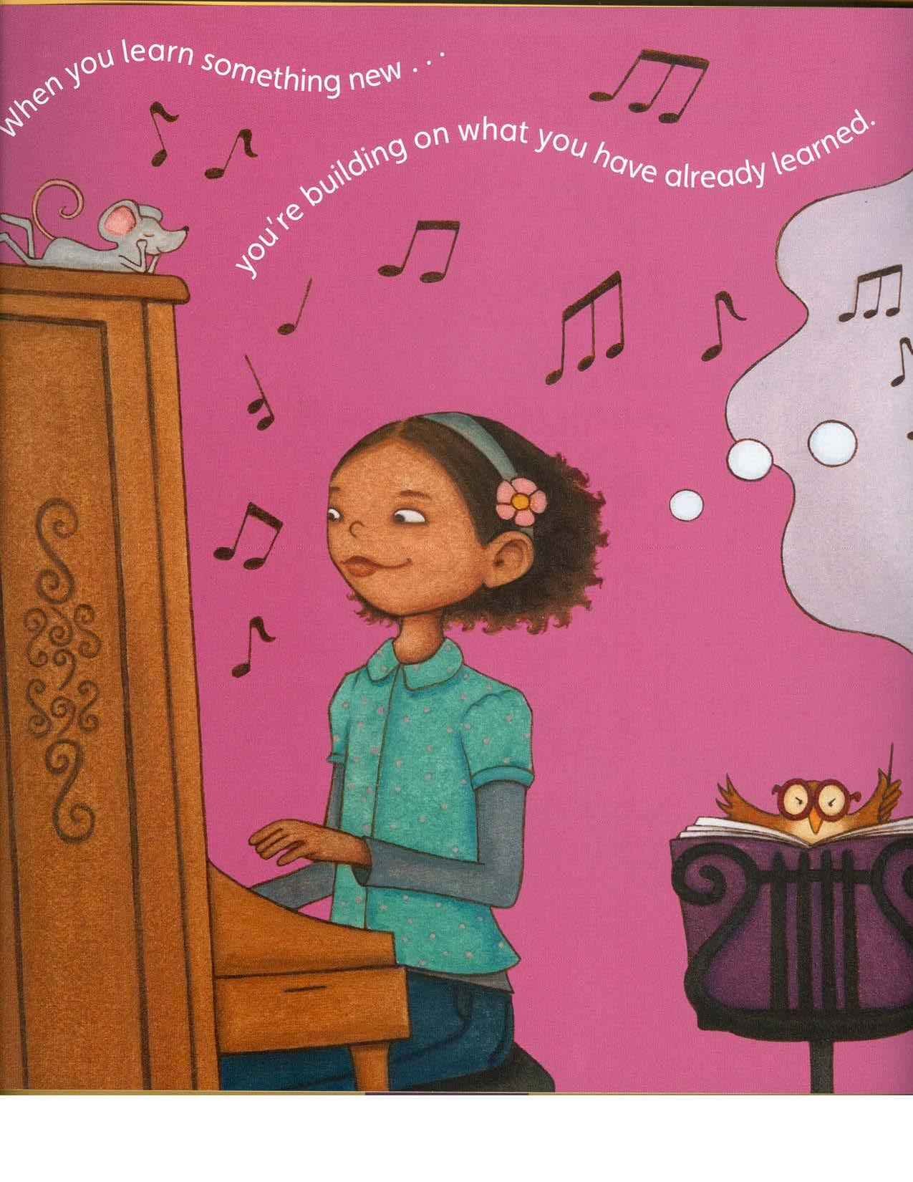

Slide 31
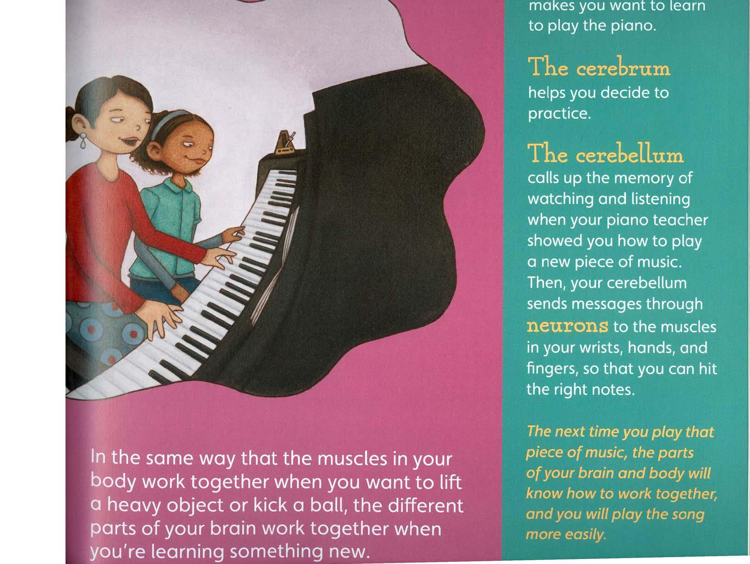
The amygdala

Slide 32
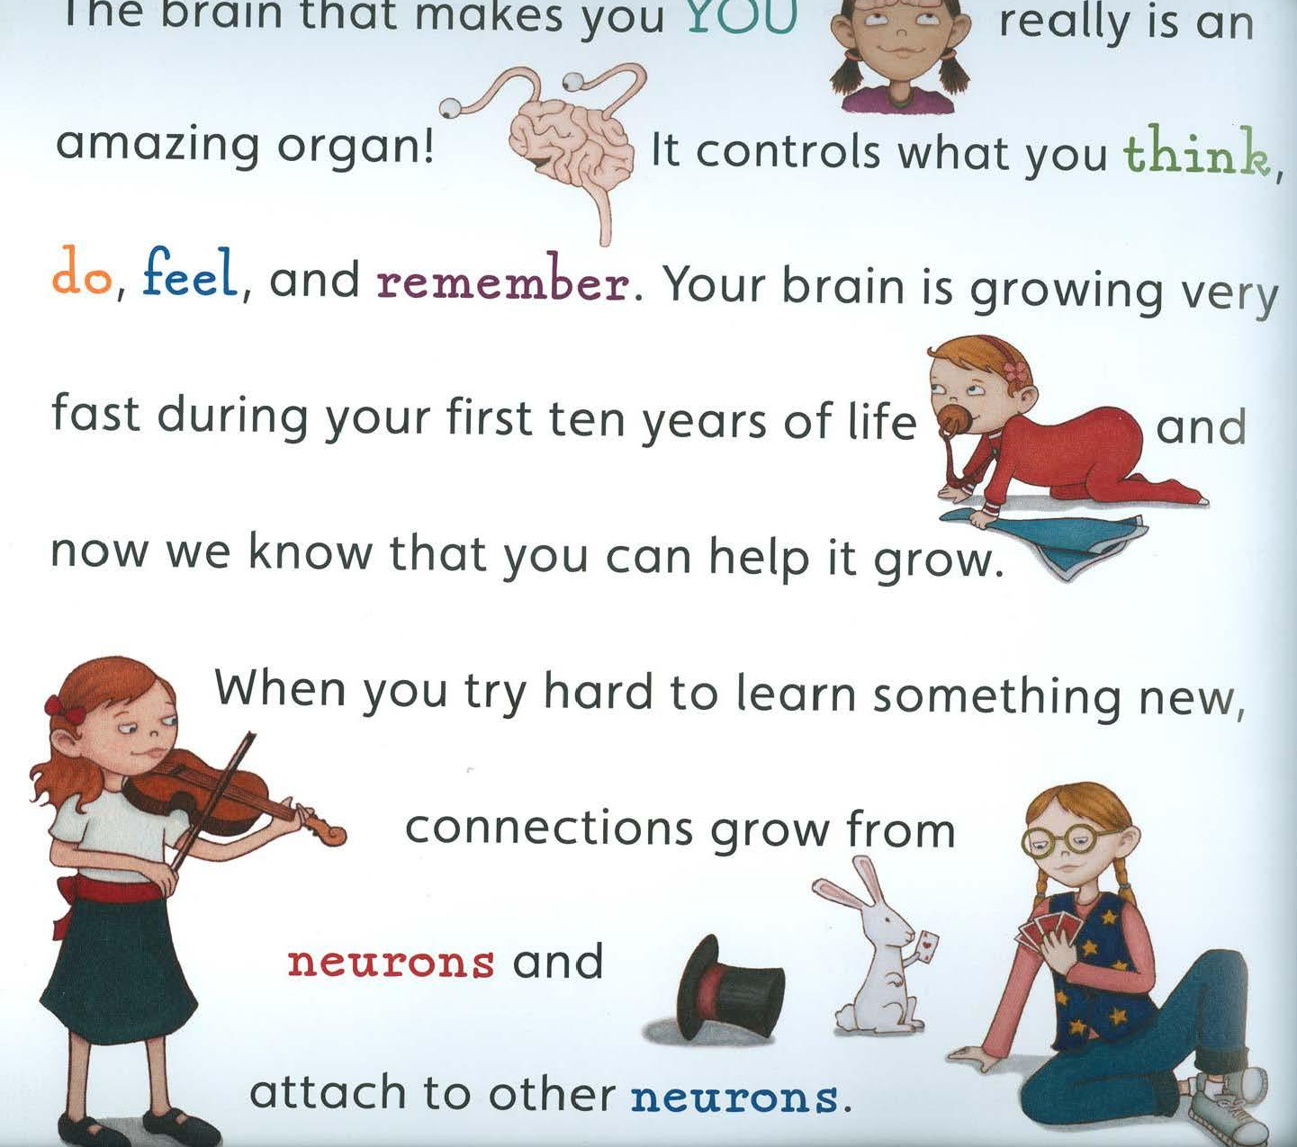

Slide 33
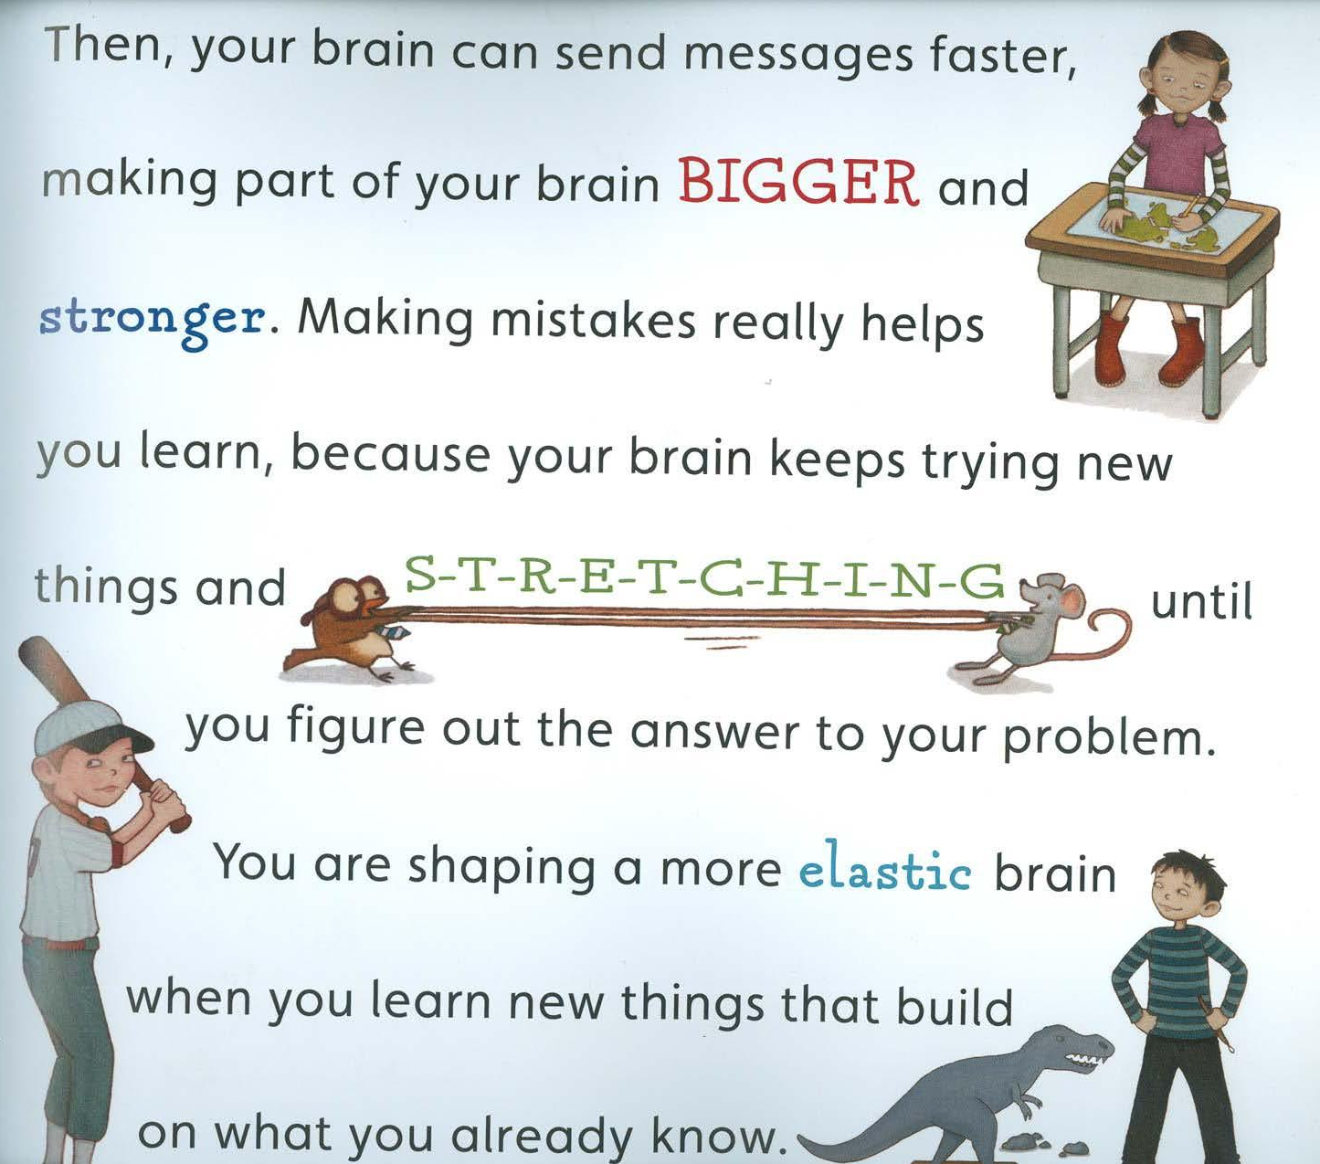

Slide 34
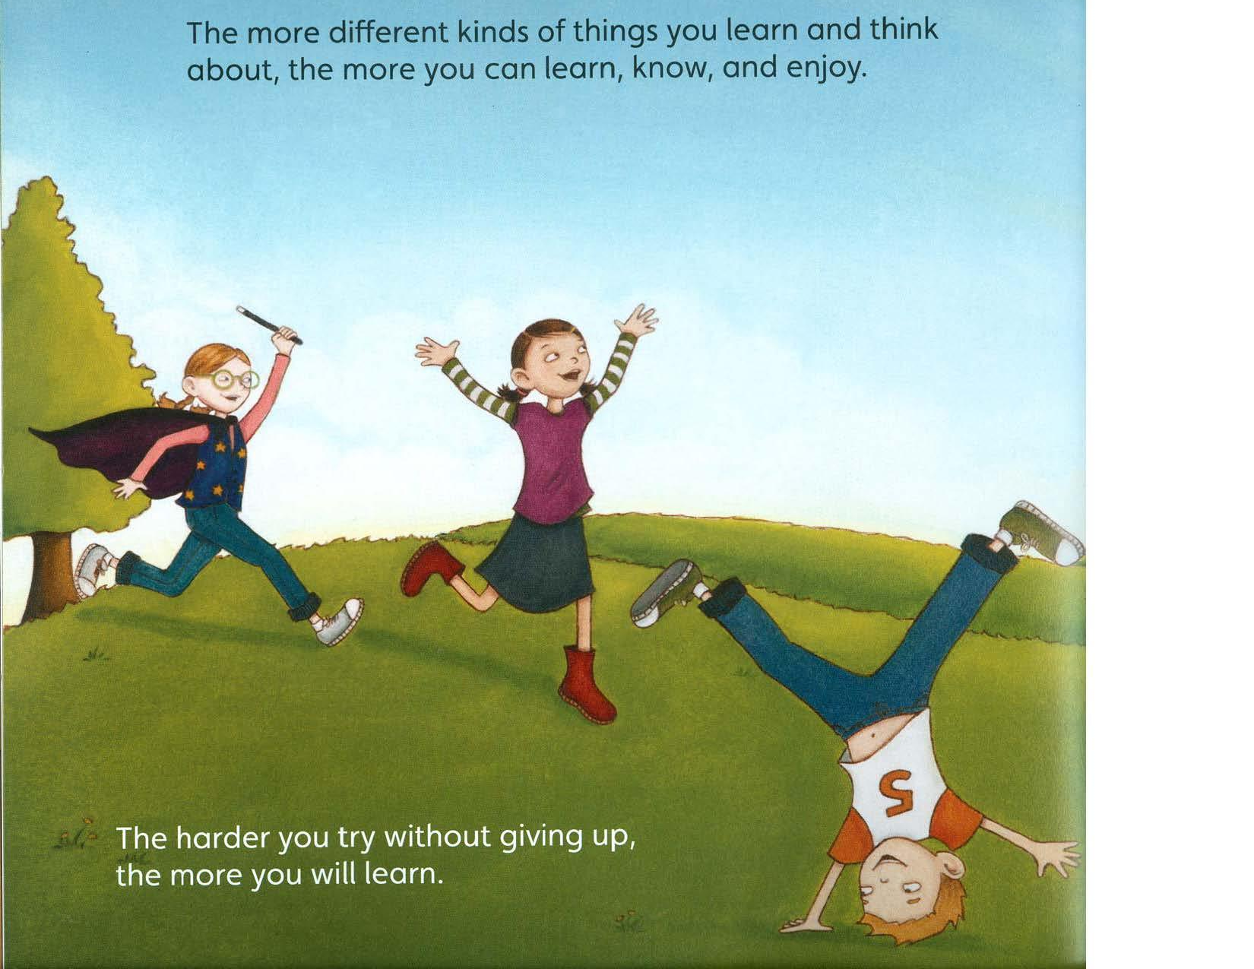

Slide 35
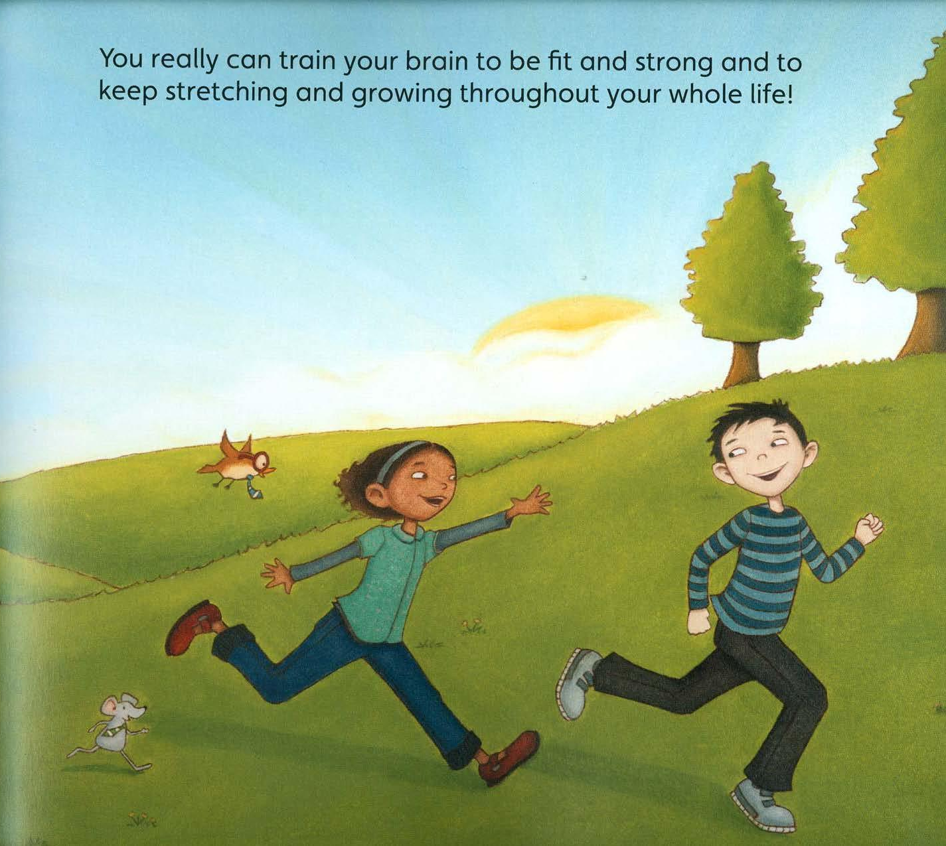

Slide 36
What Did We Learn?
Take your brain drawing and notes with you.
Stand up, hand up, high five someone and share a cool fact you learned!
Repeat this three times and then return to your desks!

Slide 37
Your Fantastic, Elastic Brain: Stretch It, Shape It
by Joann Deak - Some Main Ideas
Your brain can grow and get stronger
Neurons in your brain make new pathways or connections when you learn.
Your brain is like a muscle.
Exercise (learning and embracing challenge) is good for your brain.
When you learn something that is at first challenging,
keep practicing! This helps your brain get stronger.

Slide 38
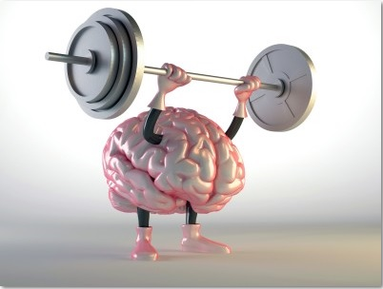
Ready For A Brain Workout Again?
Go back to your popsicle partner.
Go back to the same jigsaw.
B goes first, and A records time on stickee.
Then A goes, and B records time on stickee.
Did your time improve?
Can you feel your brain growing?

Slide 39
Exit Ticket!
Choose one of the following:
What stuck with you today? What is an interesting fact you are going to share with your parents tonight?
What is a question you still have?
How are you going to apply this knowledge to your life?
Park your ticket on the exit slip board!

